Slide 1

Android Application Penetration Testing
This workshop will explore techniques and methodologies for assessing the security posture of Android applications, from architectural analysis to hands-on exploitation of common vulnerabilities.
SK
by Sheshananda Reddy Kandula

Slide 2
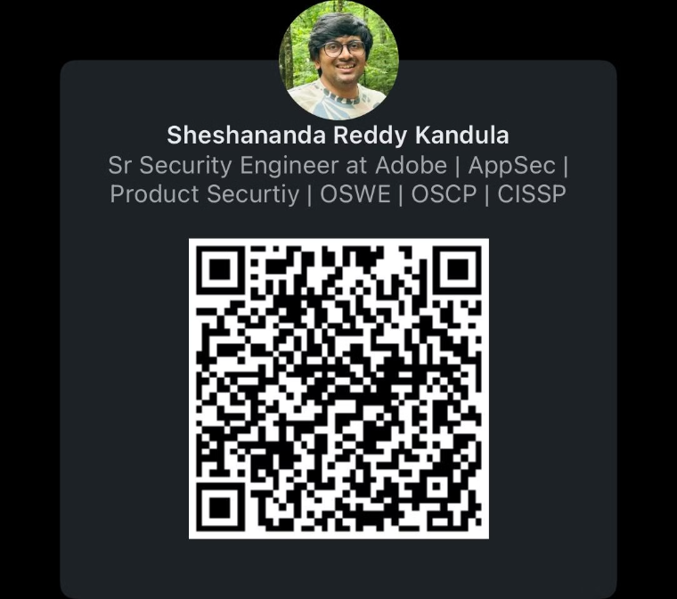
Whoami
@Sheshananda Reddy Kandula

Slide 3
Agenda
Introductions
Introduction to Android Application Structure
Platform Security Controls that protect Android app
Android Studio and Installing Emulator
Building a Simple Android App with Android Studio
Tools for pen testing Android App
Damn Vulnerable Apps for learning
Exploiting few vulnerabilities,
Next Steps to take it further

Slide 4
Agenda
Topics Estimated Timeline
Start @ 1 PM EST
Introductions
Introduction to Android Application Structure
2 PM EST
Platform Security Controls that protect Android app
Android Studio and Installing Emulator
Core Android App Components
Building a Simple Android App with Android Studio
Common vulnerabilities in Android app and Mobile OWASP Top 10
3 PM EST
Static Code Analysis Techniques
Dynamic Code Analysis Techniques
Tools for pen testing Android App
4 PM
Damn Vulnerable Apps for learning
Installing Burp Certificate on Emulator/Device for Proxy
Exploiting few vulnerabilities,
Next Steps to take it further

Slide 5

Introduction to Android Application Security
Android's open-source nature and diverse ecosystem introduce unique security challenges. Apps handle sensitive user data and often integrate with device hardware and services. Secure design, coding practices, and rigorous testing are critical to mitigate risks. Penetration testing helps identify and address vulnerabilities before malicious exploitation.

Slide 6
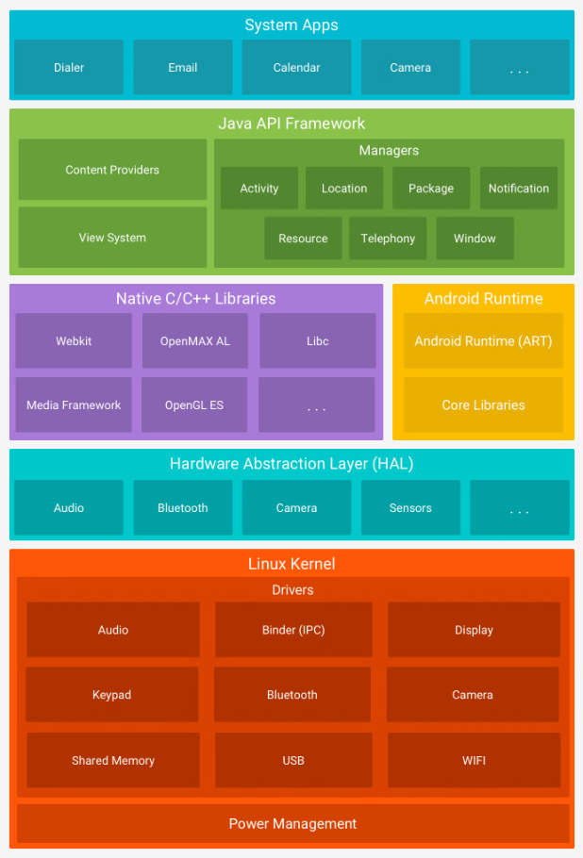
Android Platform Architecture
https://developer.android.com/guide/platform
Notes:
* Linux Kernel Layer The Linux kernel is the base of the Android OS, managing core system services like memory, process management, networking, and security. It also includes drivers for device hardware, abstracting the details of hardware interaction and providing interfaces for higher-level components. * Hardware Abstraction Layer (HAL) The HAL serves as an intermediary, allowing the Android system to interact with device hardware without knowing hardware specifics. For each hardware type (such as Bluetooth or WiFi), there’s a corresponding HAL module, enabling Android’s high-level APIs to perform operations regardless of device manufacturer specifics. * Android Runtime (ART) Android Runtime is where Android applications run. Each app operates in its own ART instance, providing isolation, security, and optimized performance. * Native C/C++ Libraries Android includes a set of core libraries written in C/C++ that handle essential functions such as graphics rendering, media playback, and database management. * Java API Framework The Java API Framework is the core of Android app development. It provides high-level services and is organized into components like: * Activities and Fragments: For UI and lifecycle management. * Content Providers: To manage data sharing between applications. * Services: For background processing. * Broadcast Receivers: For handling system-wide broadcast announcements. * Resource Manager: Manages app resources like strings, layouts, and drawable assets. * System Apps System apps provide essential functionality and include apps like the dialer, SMS, and email client. These interact with the Java API Framework and provide standardized features users expect from Android devices.

Slide 7
Android Platform Security Controls
Application Sandbox
Each app runs in an isolated environment, preventing unauthorized access to other apps' data.
Permissions System
Runtime Permissions (Android 6.0+): User-granted permissions for sensitive actions.
Encryption & Storage Security
File-Based Encryption (FBE): Secures data at rest with hardware-backed encryption.
KeyStore & TEE: Protects cryptographic keys and sensitive operations.
Authentication Mechanisms
Biometrics & Multi-Factor: Secure access using fingerprints, facial recognition, and traditional PIN/password.
Secure Boot & Verified Boot
Validates each OS layer during boot to ensure integrity, with rollback protection.
Google Play Protect
Scans apps for malware and enforces app security on the Play Store.
SELinux & Access Control
Enforces strict security policies, containing apps within defined boundaries.

Slide 8

Android Application Architecture and Ecosystem
Android apps are built using a modular architecture with distinct components like Activities, Services, and Broadcast Receivers.
The Android OS and its extensive API ecosystem enable rich functionality but also introduce potential security risks.
The open Android app distribution model allows for a diverse range of apps, many of which may have vulnerabilities.
Understanding the Android platform's architecture and ecosystem is crucial for effective penetration testing.

Slide 9
Core Android Application Components
Activities
Purpose: Manages the user interface and handles user interactions for a single screen.
Example: Login screen, profile page.
Services
Purpose: Runs long-running operations in the background without a UI.
Example: Playing music, fetching data, sending notifications.
Broadcast Receivers
Purpose: Responds to system-wide broadcast announcements (e.g., battery low, Wi-Fi connected).
Example: Listening for boot completion or network changes.
Content Providers
Purpose: Manages shared data between apps securely, allowing controlled access to databases.
Example: Contacts app sharing data with the messaging app.

Slide 10
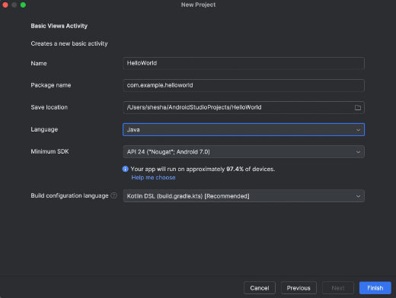
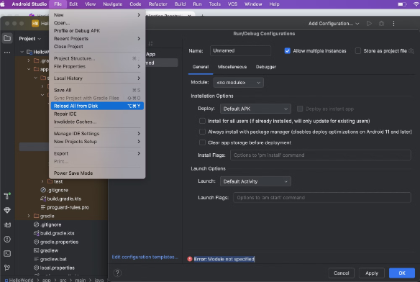
Hello World Android Application
Let's Start with creation of Sample App.

Slide 11
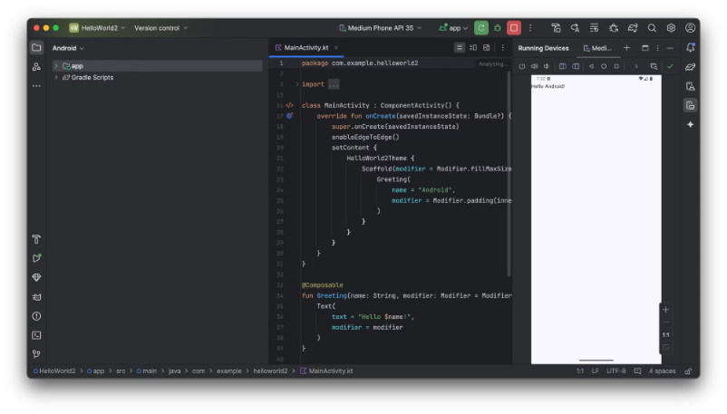
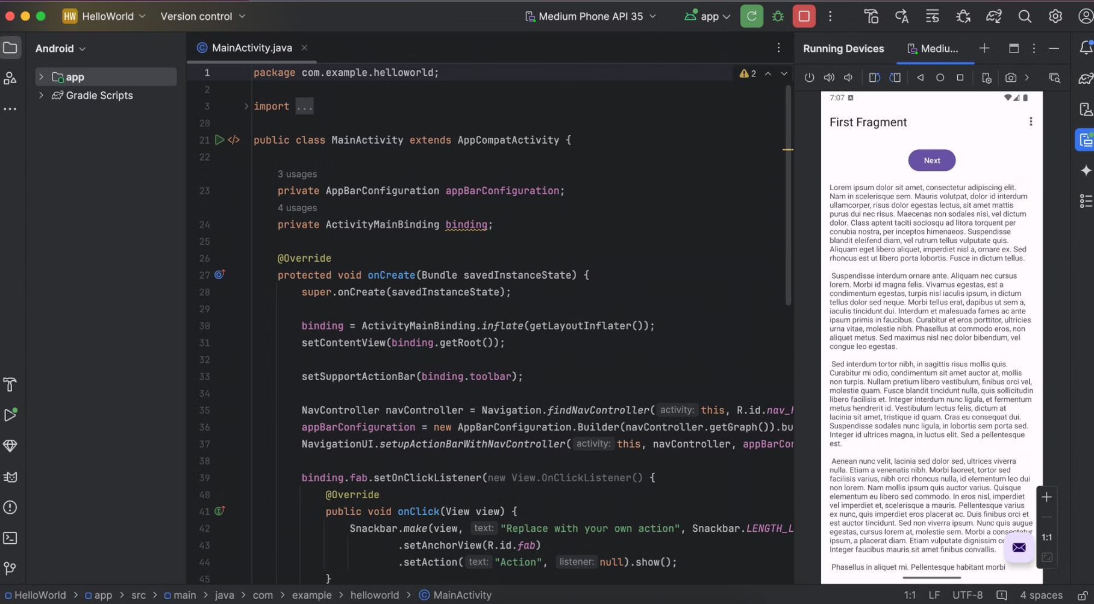
First App

Slide 12
Installing ADB (Android Debugging Bridge)
Install the homebrew package manager
/bin/bash -c "$(curl -fsSL https://raw.githubusercontent.com/Homebrew/install/master/install.sh)"
Install adb
brew install android-platform-tools
Start using adb
adb devices
Notes:
eval "$(/opt/homebrew/bin/brew shellenv)" for Mac M chips

Slide 13
Using Android Studio Emulator with Root Access
The Android Studio Emulator has built-in support for root access, though not all system images allow rooting. Here’s how to set it up:
Open Android Studio:
Open Android Studio, and go to Tools > AVD Manager (Android Virtual Device Manager).
Create a New Virtual Device:
Click on Create Virtual Device and select a device profile (e.g., Pixel 5).
Select a System Image:
Choose a system image that’s compatible with rooting. x86 or x86_64 images (e.g., Android 11 or 12) often have better root support.
Recommended: Choose the system images labeled Google APIs rather than Google Play because Google Play images are usually locked down and cannot be rooted.
Finish Setting Up the Emulator:
Complete the setup and start the emulator.
Verify Root Access:
Once the emulator is running, open a terminal or use Android Studio’s Terminal.
Run the following command to connect to the emulator:
Few commands:
This command restarts the adb daemon with root privileges.
Now, check for root access by running:
If you see root as the output, the emulator has root access.
adb devices
adb root
adb shell
whoami
id

Slide 14
Conti…
Below is the expected behavior
(dev) ➜ APKs git:(main) ✗ adb devices
List of devices attached
(dev) ➜ APKs git:(main) ✗ adb devices
List of devices attached
emulator-5554 offline
(dev) ➜ APKs git:(main) ✗
(dev) ➜ APKs git:(main) ✗ adb devices
List of devices attached
emulator-5554 device
(dev) ➜ APKs git:(main) ✗ adb shell
emulator64_x86_64:/ $ su
emulator64_x86_64:/ # id
uid=0(root) gid=0(root) groups=0(root),1004(input),1007(log),1011(adb),1015(sdcard_rw),1028(sdcard_r),1078(ext_data_rw),1079(ext_obb_rw),3001(net_bt_admin),3002(net_bt),3003(inet),3006(net_bw_stats),3009(readproc),3011(uhid),3012(readtracefs) context=u:r:su:s0
emulator64_x86_64:/ # ls /data/data/
android com.android.providers.contacts
android.auto_generated_rro_product__ com.android.providers.downloads
android.auto_generated_rro_vendor__ com.android.providers.downloads.ui
android.slim.overlay com.android.providers.media
com.android.backupconfirm com.android.providers.partnerbookmarks
com.android.bips com.android.providers.settings
com.android.bluetooth com.android.providers.settings.auto_generated_rro_vendor__
com.android.bluetoothmidiservice com.android.providers.telephony
com.android.bookmarkprovider com.android.providers.userdictionary
com.android.calllogbackup com.android.proxyhandler
com.android.cameraextensions com.android.remoteprovisioner
com.android.carrierconfig com.android.se

Slide 15

ADB - Android Debug Bridge
#basic commands
adb devices
adb shell
adb push ./file /sdcard/
adb pull /sdcard/file .
adb install file.apk
# Looking for the application and it's path
adb shell pm list packages
adb shell pm list packages -3
adb shell dumpsys package <package-name>
adb shell pm path <package-name>
# logcat
adb logcat "MainActivity:V *:S"
adb logcat -v "brief"
Helpful commands
adb exec-out screencap -p > screenshot.png
adb shell screencap /sdcard/screencap.png
adb shell screenrecord /sdcard/screenrecord.mp4

Slide 16
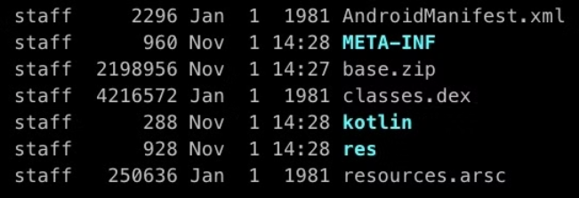
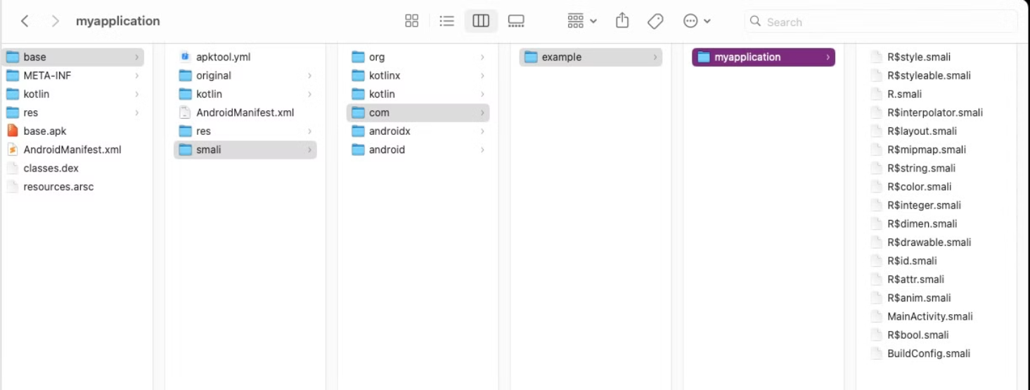
Android Application File Structure

Slide 17
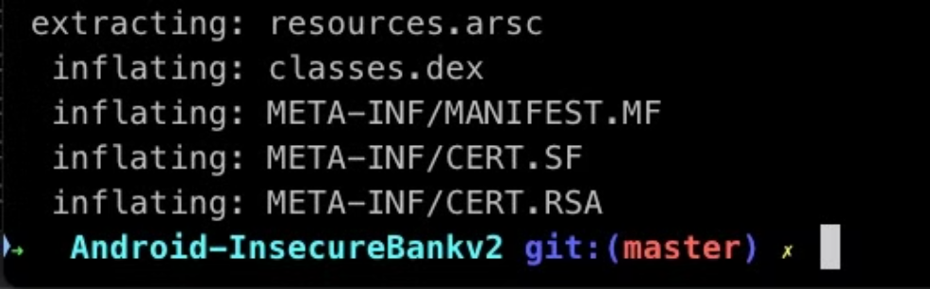
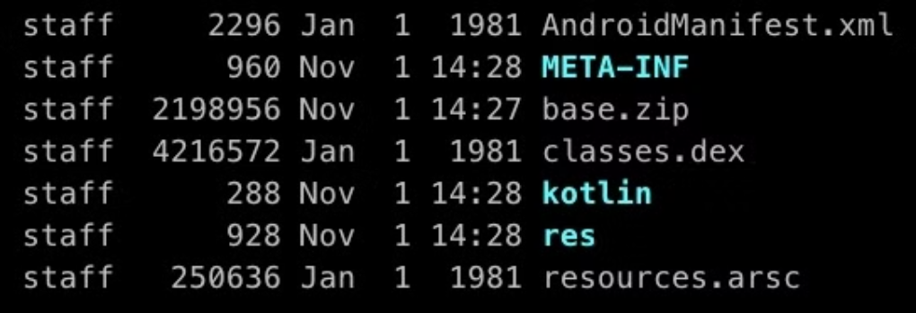
Android Application File Structure

Slide 18

Common Android Security Vulnerabilities
1
Insecure Data Storage
2
Authentication and Authorization Flaws
Apps may store sensitive data like credentials and PII insecurely on the device.
Weak or missing authentication mechanisms can allow unauthorized access.
3
Vulnerable Inter-component Communication
Improper handling of intents and other IPC channels can lead to exploits.

Slide 19

Mobile OWASP Top 10 Risks
M1: Improper Credential Usage
M2: Inadequate Supply Chain Security
M3: Insecure Authentication/Authorization
M4: Insufficient Input/Output Validation
M5: Insecure Communication
M6: Inadequate Privacy Controls
M7: Insufficient Binary Protections
M8: Security Misconfiguration
M9: Insecure Data Storage
M10: Insufficient Cryptography

Slide 20
Static Code Analysis Techniques
Automated Source Code Scanners
Manual Code Review
Decompilation Tools
Taint Analysis
Manual code review by security experts uncovers subtle vulnerabilities and design flaws.
Decompilation tools extract Java/Kotlin source code from Android APKs for in-depth analysis.
Taint analysis and data flow tracking detect improper handling of sensitive data.
Automated source code scanners identify security anti-patterns, implementation errors, and compliance issues.

Slide 21
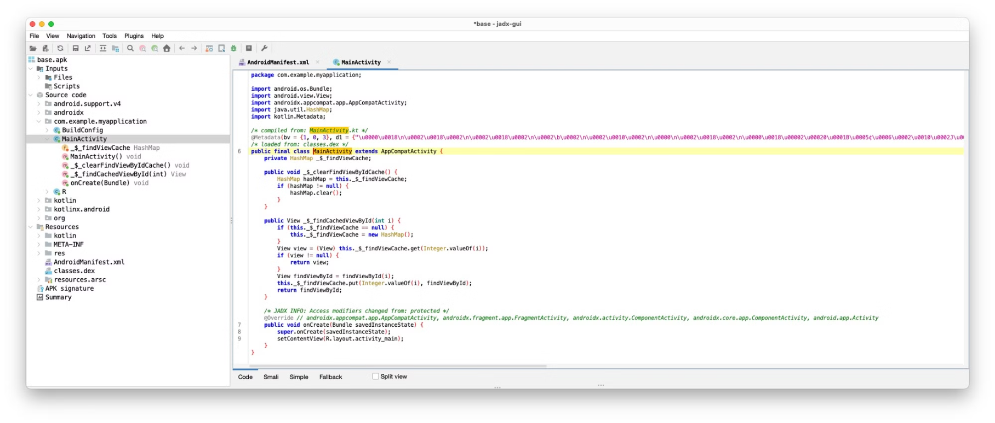
Static Code Analysis Tools
APK tool https://apktool.org/
Jadx-gui https://github.com/skylot/jadx
semgrep https://github.com/mindedsecurity/semgrep-rules-android-security
➜ tmp apktool d base.apk
I: Using Apktool 2.10.0 on base.apk with 12 thread(s).
I: Baksmaling classes.dex...
I: Loading resource table...
I: Decoding file-resources...
I: Loading resource table from file: /Users/dhanvi/Library/apktool/framework/1.apk
I: Decoding values */* XMLs...
I: Decoding AndroidManifest.xml with resources...
I: Regular manifest package...
I: Copying assets and libs...
I: Copying unknown files...
I: Copying original files...

Slide 22

Dynamic Analysis and Runtime Instrumentation
Runtime Analysis Tools
Runtime analysis tools like Frida and Xposed enable hooking into app execution for in-depth security evaluation.
1
2
Dynamic Instrumentation
Dynamic instrumentation techniques can monitor app behavior, manipulate inputs, and detect runtime vulnerabilities in a live environment.

Slide 23
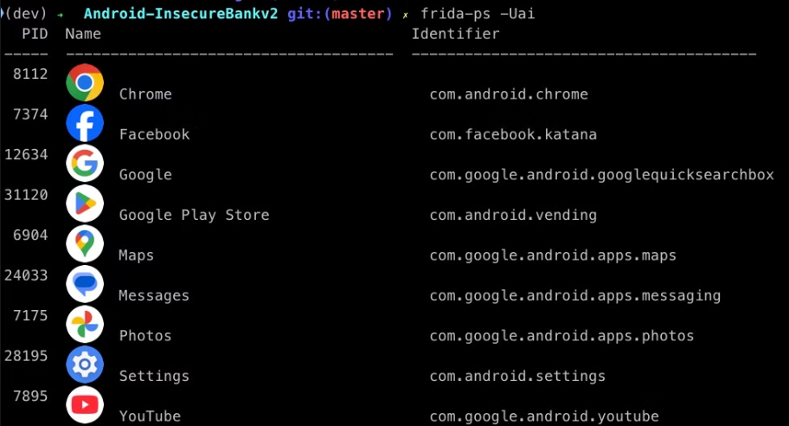
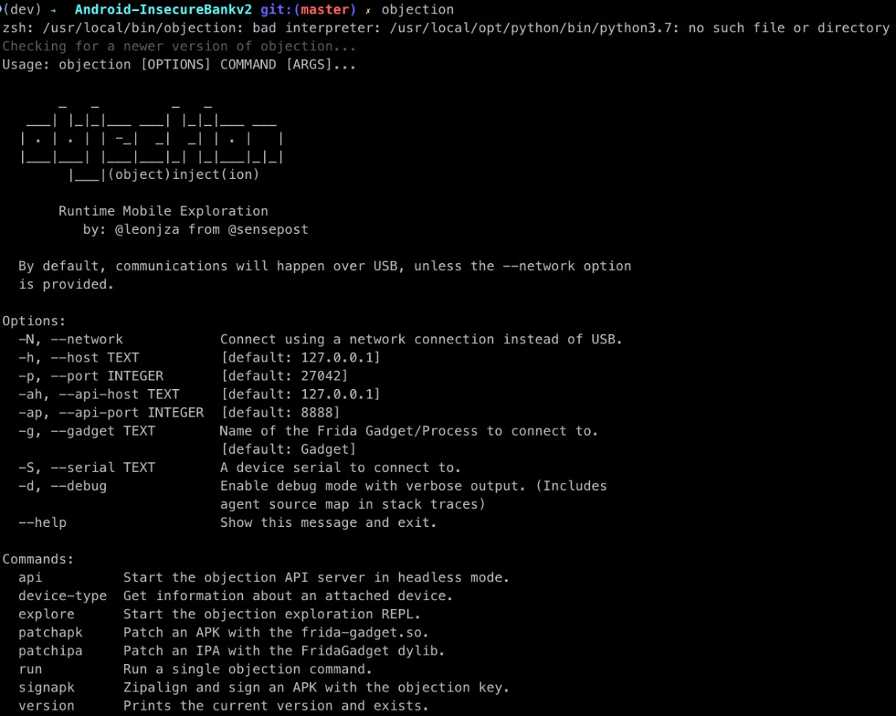
Dynamic Tools
Frida : https://frida.re/docs/android/
Objection : https://github.com/sensepost/objection
pip3 install objection
frida-ps -Uai
objection --gadget asvid.github.io.fridaapp explore
Ref: https://book.hacktricks.xyz/mobile-pentesting/android-app-pentesting/frida-tutorial/objection-tutorial
Notes:
Frida Labs to learn more: https://github.com/DERE-ad2001/Frida-Labs/tree/main

Slide 24




Testing for Insecure Data Storage
Identify Sensitive Data
Identify app components that handle sensitive data like credentials, PII, and financial information.
Examine Data Storage
Examine where and how this data is stored on the device, including the Android file system and SQLite databases.
Assess Security Measures
Assess the use of encryption, access controls, and other security measures to protect data at rest.

Slide 25
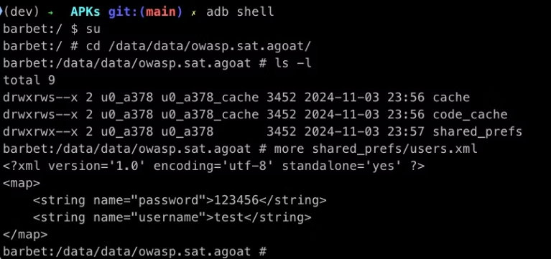
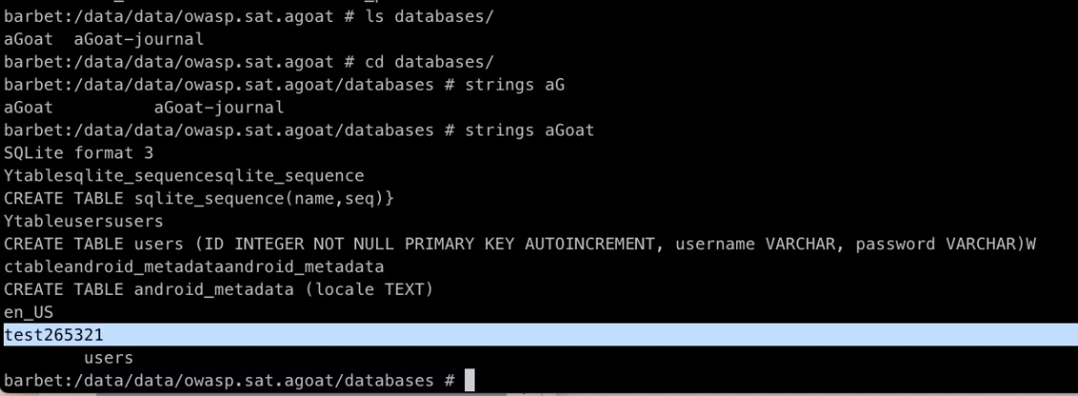
Damn Vulnerable Apps
AndroGoat: https://github.com/satishpatnayak/AndroGoat
HexTree AttackSurface APK: https://app.hextree.io/courses/intent-threat-surface/intents-and-activities/practice-startactivity

Slide 26

Identifying and Exploiting Authentication Flaws
Assess Authentication Controls
Bypass Authentication
Attempt to bypass, bruteforce, or otherwise circumvent authentication to gain unauthorized access to sensitive app functionality.
Assess authentication controls like password policies, multi-factor options, and account lockout mechanisms.

Slide 27
AndroGoat
Verify PIN Functionality to download the invoice

Slide 28

Attacking Android Inter-Component Communication
Android's open IPC model allows apps to share data and functionality, but can also enable unauthorized access if not properly secured.
Identify and analyze intent handling, URIs, and other IPC mechanisms for vulnerabilities that could lead to privilege escalation or data leakage.

Slide 29
AttackSurface APK
Intents attacks
Flag 8 : Activity checking function name
Flag 10: Implicit Intent
Notes:
AttackSurfacePoC project is for Flag5 and Flag6 Flag5 is intent in intent Flag6Activity is not exported. but we can start from Flag5Activity Flag8 project has the code. MainActivity starts the next activity (Hextreetest). Since Flag8Activity has the code check for callee function name contains Hextree. Flag8 app already installed. Flag9: same as previous one. But use Utils.showDialog Flag10: Implicit Intent We need to create an activity and add intent-filter to listen for implicit intent. That is send by Flag10Activity of the AttackSurface app. Flag 5 and 6 @Override protected void onCreate(Bundle savedInstanceState) { super.onCreate(savedInstanceState); setContentView(R.layout.activity_main); Button homeButton = findViewById(R.id.home_button); homeButton.setOnClickListener(new View.OnClickListener() { @Override public void onClick(View view) { Log.i("HEXTREE","Welcome from the button click"); Intent intent = new Intent(); Intent secondIntent = new Intent(); Intent nextIntent = new Intent(); secondIntent.putExtra("return", 42); nextIntent.putExtra("reason", "back"); secondIntent.putExtra("nextIntent", nextIntent); //intent.putExtra("state", 4); intent.putExtra("android.intent.extra.INTENT", secondIntent); intent.setComponent(new ComponentName("io.hextree.attacksurface","io.hextree.attacksurface.activities.Flag5Activity")); startActivity(intent); } }); }

Slide 30
MyDevices Beta
Notes:
MyDevices Beta: flag{D33pL1nk5_CDn_B3_1n53cu23} It's a deeplink: adb shell am start -n unknown link -a "android.intent.action.VIEW" -d "webview://url/deeplink-secret-intent-data"

Slide 31

Automated Android Pentesting Tools and Frameworks
Frida enables dynamic instrumentation for runtime analysis and exploit development.
MobSF is an open-source, all-in-one mobile app pentesting framework.
Drozer is a comprehensive security assessment and exploitation framework for Android.
Apktool allows for reverse-engineering, modifying, and rebuilding Android apps.

Slide 32
MobSF Framework and Demo
MobSF: https://github.com/MobSF/Mobile-Security-Framework-MobSF
docker pull opensecurity/mobile-security-framework-mobsf:latest
docker run -it --rm -p 8000:8000 opensecurity/mobile-security-framework-mobsf:latest

Slide 33
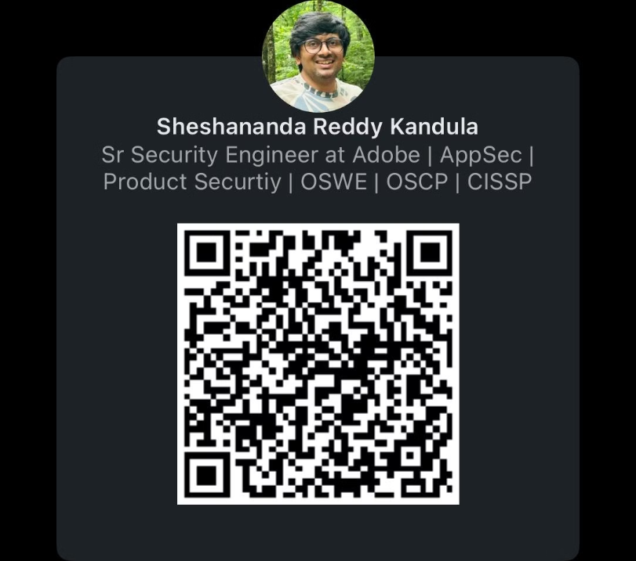
Thank You!!

